Slide 1
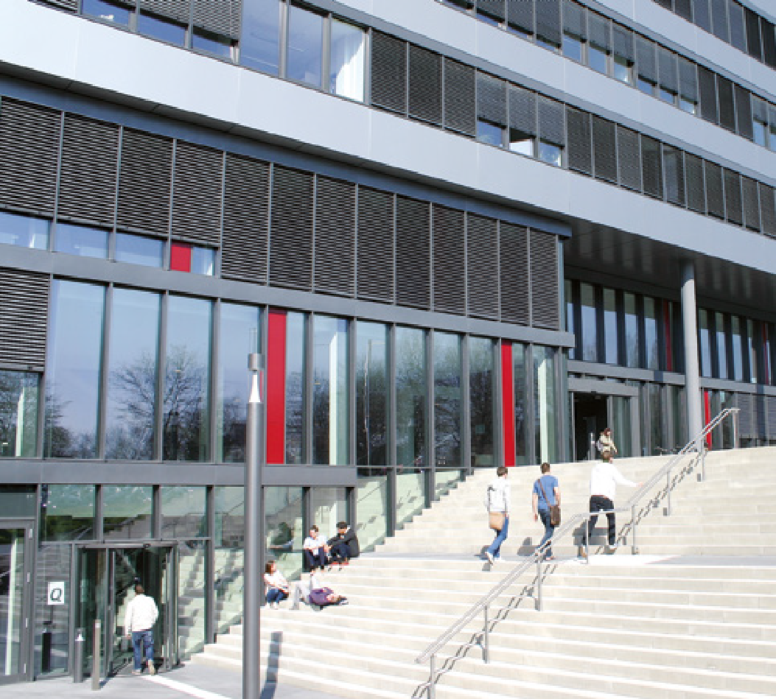
Interactive Data Visualization (SS 2020)
Assignment 5 (Mini project)
Topic: COVID-19
GROUP 02

Slide 2
Who we are
… and what we show
Julia Bresien
Christopher Schrewing
Rigers Sulku
Tejas Ravindra Dhawale
Soundarya Krishnan
User and Task
The Data
The Visualization
The Interactions
Concept & Responsibilities

Slide 3




User and Task(s)
Summer holidays are coming close!
?
?
Uncertainty due to coronavirus
Icons made by Freepik and Eucalyp on www.flaticon.com
Amount of requests might be overwhelming for travel agencies
→ Users are travel agencies and travelers having the problem of deciding where to go for their holiday

Slide 4
User and Task(s)
How is the current situation of active cases in a country considering its total population?
What was the course of active cases in a country?
In which country is it most likely to get in contact with someone who currently has the coronavirus?

Slide 5
The Data - CHRIS

Slide 6
The Interactions - TEJAS
maybe no slides at all but only direct live demo?

Slide 7
Concept
Problem
Visualize real-time global COVID19 affected cases and trace its evolution
Data and data preprocessing
Data model and handle data discrepancies
Data Visualization
Geospatial Choropleth map for effective and expressive interpretation
Interaction
Country-specific and time series information

Slide 8
Responsibilities
Effective teamwork
Good collaboration through frequent virtual meetings
Every member contributed during conceptualization & implementation
Member specific roles:
Member | Main responsibility
Soundarya | Concept
Tejas | Research on different visualizations and interactions
Christopher | Preprocessing data, merging different datasheets
Rigers | Time slider in visualization
Julia | Basic information, presentation

Slide 9
Thank you
&
Have fun using our interactive visualization

